Slide 1

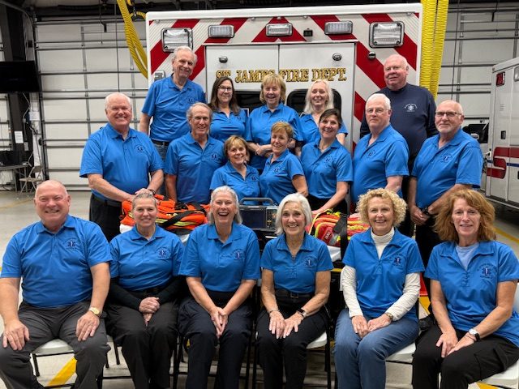
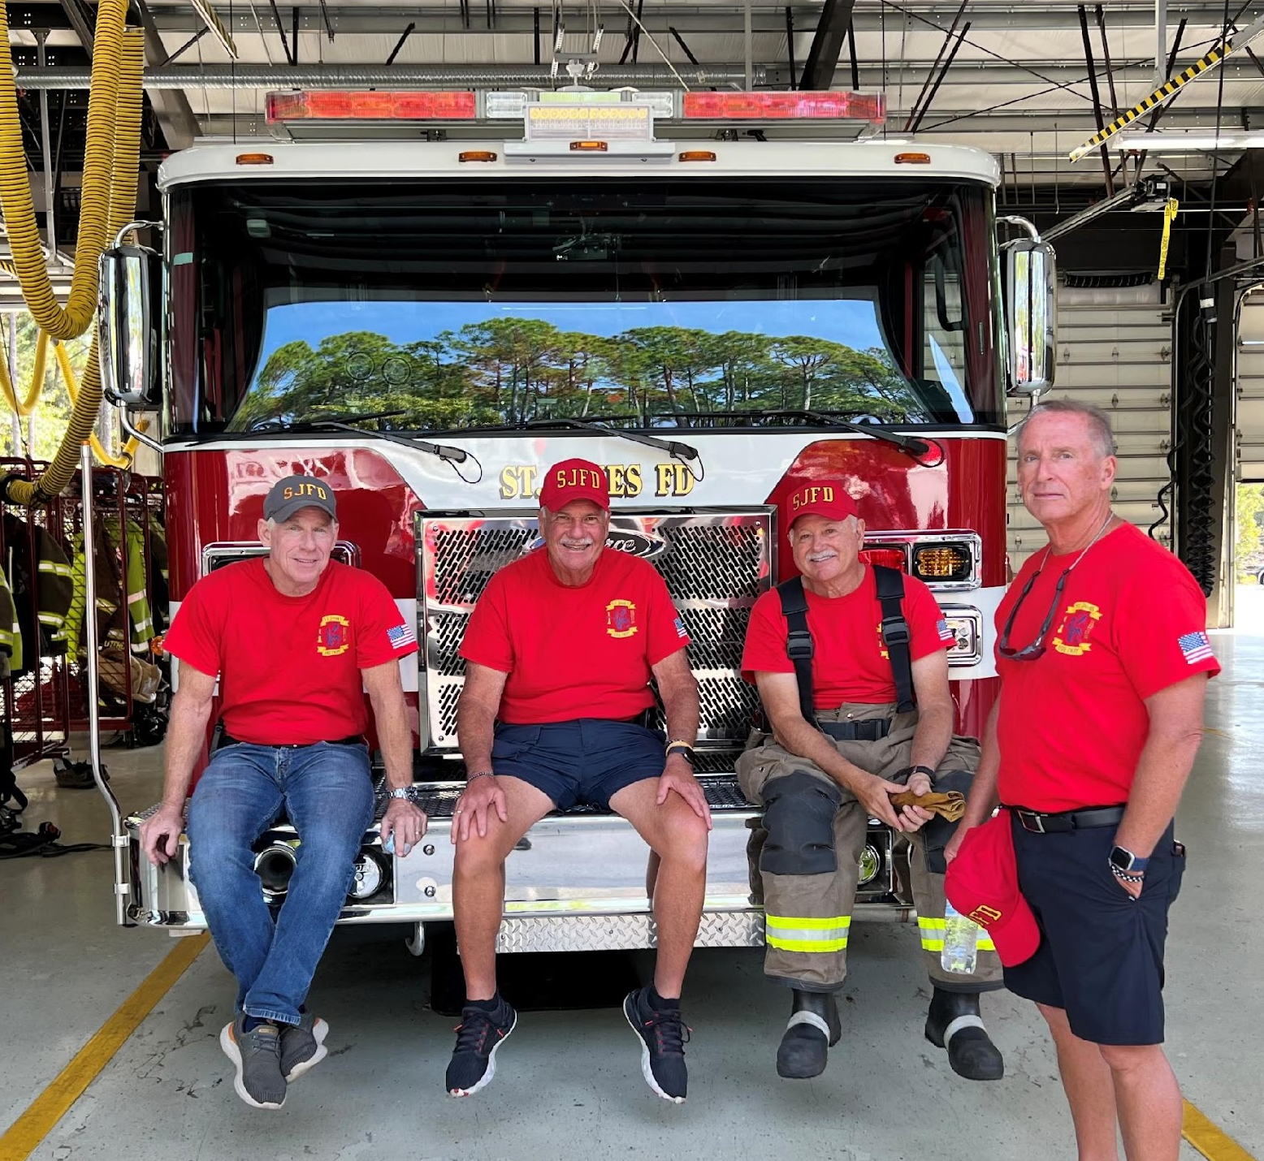
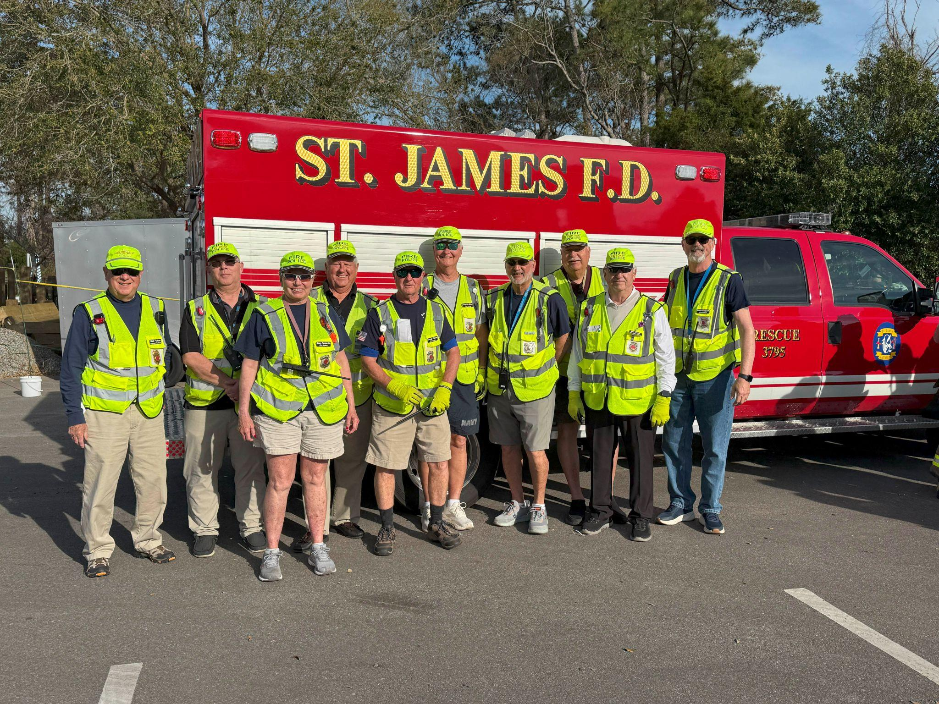
St. James Fire Department Annual Meeting 2025
A Professional Department Run By Volunteers

Slide 2
Agenda
2025 Election Results
President's Report
Treasurer's Financial Report
Chief's Operations Report
FY 2025 Recruitment
2025 Highlights
Public Q & A
Adjournment

Slide 3
President's Welcome
Call to Order & Pledge of Allegiance
Introductions
Garren Foy, VP & Recruitment
Dan Beharry, Secretary & Communications/PR
Rich Agar, Treasurer
Scott Boyer, Chief
Joe Castagnola, Grants & Governance
Lynn Dutney, TOSJ Representative
Wendee Howell, Technology
Bill Lendh, STJ POA Representative
Vince Rocco, Building & Grounds

Slide 4
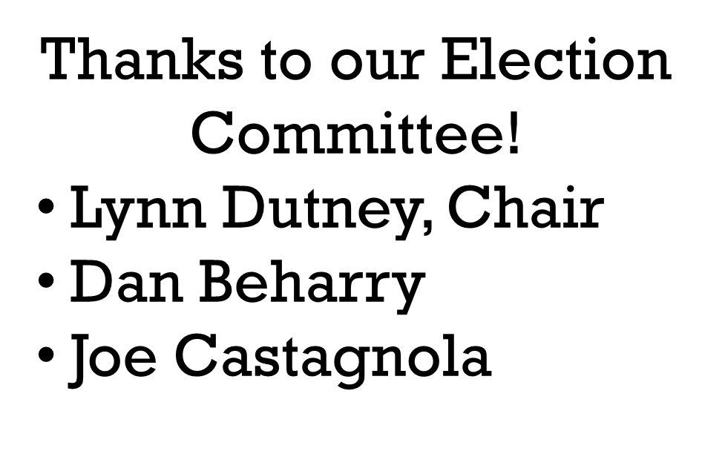
2025 Election Results
Jim Crum | 82
Garren Foy | 93
Ed Reeves | 87
Terms Expire 12/31/2030
Thank you for your service, Vince Rocco!

Slide 5
President’s Annual Report
Governance Highlights
2nd Annual Chief’s Performance Review
Monitoring Succession Plan
Five Year Plan updated and published
New Board member selected
Chief’s Retirement & Successor Selection Plan

Slide 6
Key Initiatives in Detail
Expand Recruitment Beyond St. James Plantation
Focus heavily on EMS recruitment given anticipated call volume increases
Target new residents in developments north of Highway 211

Slide 7
Key Initiatives in Detail
Enable Direct Response for Rural Volunteers
Allow EMS members from new developments to respond directly to incidents
Explore direct response options for Firefighters located in new areas
Expand Fire Police services to cover areas outside the Plantation gates and Arbor Creek

Slide 8
Key Initiatives in Detail
Infrastructure & Facilities Planning
Explore "satellite facility" north of Hwy 211 for equipment and quick response
Work with Developer and POA on Gate 5 access to improve response times to Rural Fire District

Slide 9
Key Initiatives in Detail
Equipment & Vehicles
Replace key apparatus on schedule (new pumper (2025), aerial ladder (1/2028), ambulance (2027)
Ensure equipment meets needs for multi-story building responses
Plan for new vehicle & major item purchases in 10-year rolling capital expense plan

Slide 10

Key Initiatives in Detail
See the complete 2026 - 2030 Plan at https://stjamesfire.org/5-year-plan/
Learn more about our department. Go to https://stjamesfire.org
Join our Department. Click on our QR code to get an “I’m Interested” form.

Slide 11
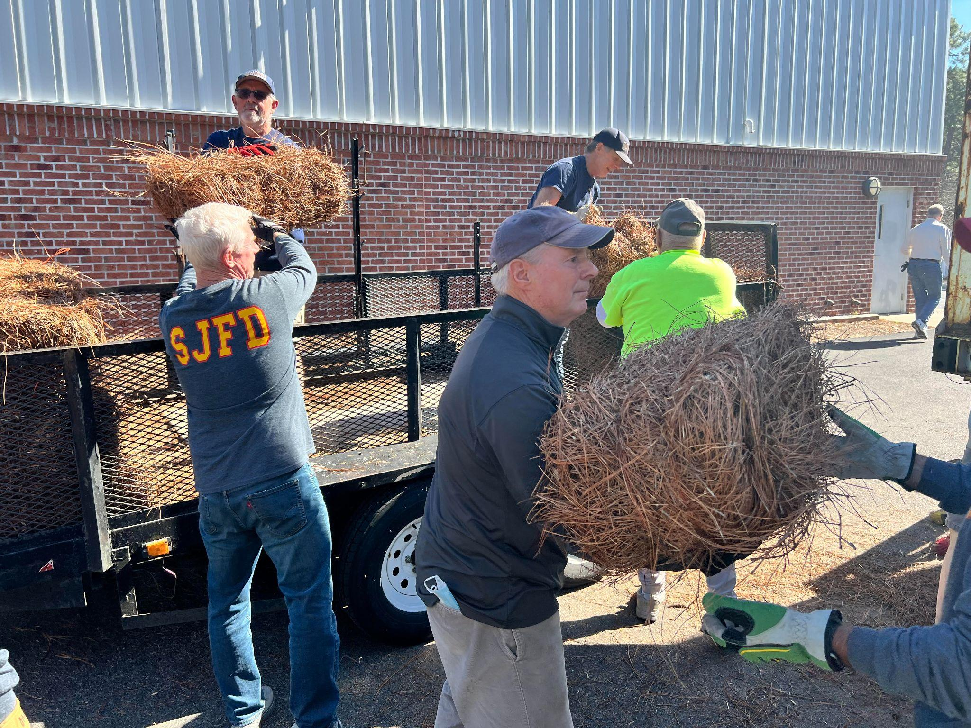
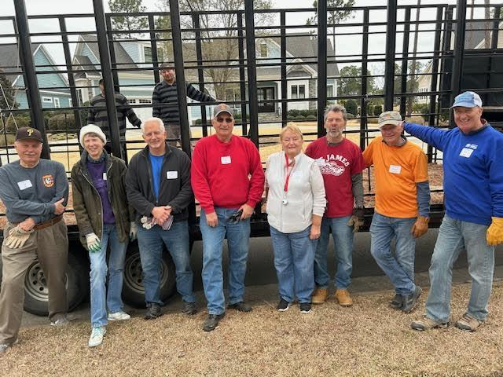
Groundcover Sales Program Ends
After 20 years and $1 Million in net proceeds, the
Biennial Groundcover Sales program has ended.
Thanks to Program Managers John Goldsworth,
John Vandergrift, Tom Grillo, Earl Williams, Kirk Davis, Steve
Dillon and Dorothy Jaeger and 100s of volunteers for a great run!
See January Cat-Tales for more information.

Slide 12
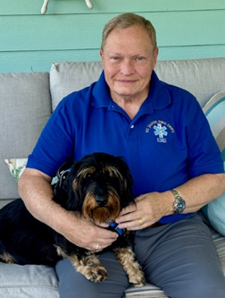
Extraordinary Service
Captain Bob Jensen, EMS
Saving lives and preparing others for the future
EMT since December 2018
LT in February 2021
CAPT in February 2022
CPR Instructor in St James & Brunsco
Staff Instructor at BCC
Good Luck, Bob, and heartfelt thanks!

Slide 13
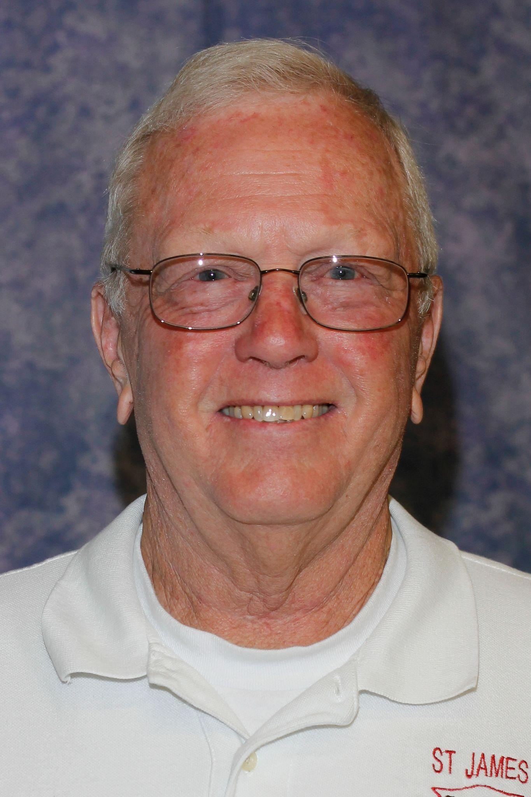
Extraordinary Service
Congratulations, John, and Thank You!
John Dahill 2005 - 2025
A Generation of Service and Commitment to St. James
Firefighter
Assistant Chief - Fire
Chief of the Department

Slide 14
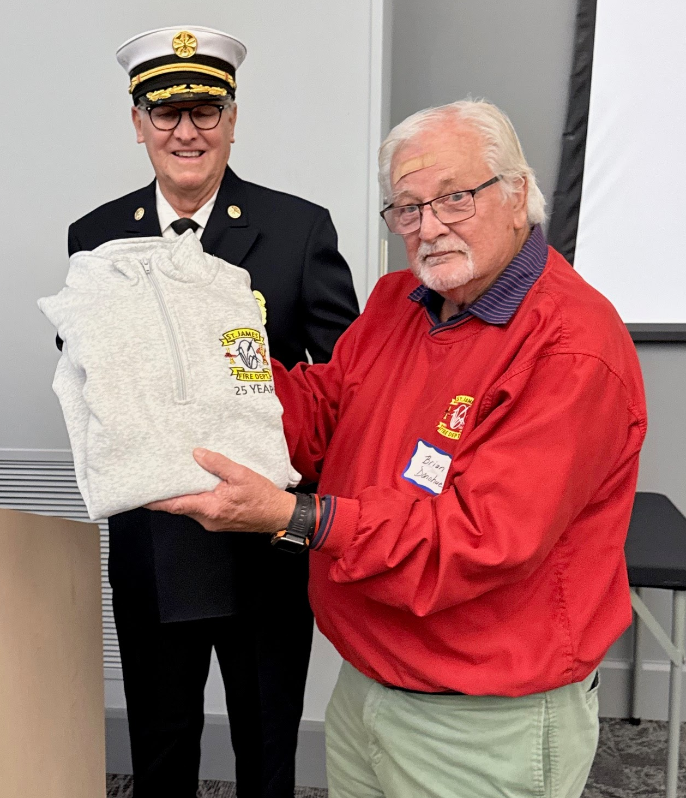
Extraordinary Service
Brian Donohue 2000 - 2025
A Lifetime of Service to St. James
Firefighter
Driver
EMT
Asst Chief EMS
Congratulations, Brian, and thank you!

Slide 15
Treasurer's Annual Report
$
Show Me The Money
June 30, 2025

Slide 16
Treasurer's Annual Report
Operating Results
Operating Income exceeded budget - $113%
Operating Expenses were below budget - $83%
Long Term Debt declined per schedule
All bills paid on time
All regulatory reports, tax returns completed on time
Unqualified Audit Report

Slide 17
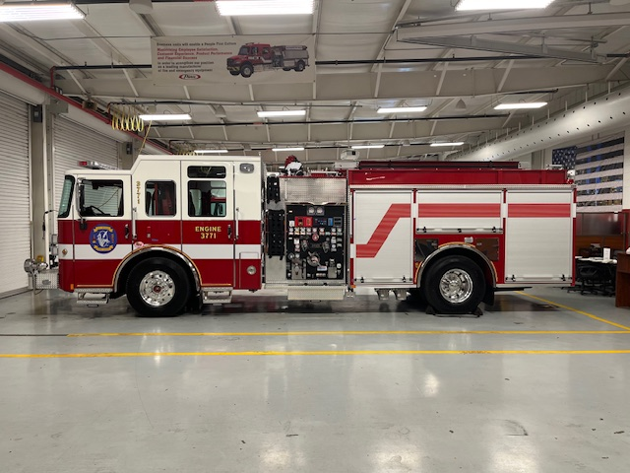
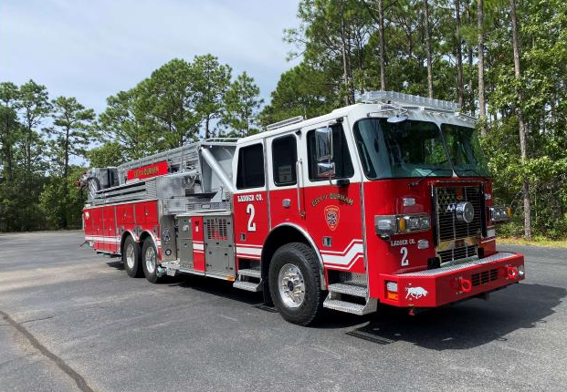
Capitalized Assets
New Pumper
Cost: $832,667
Est. Delivery: Dec 2025
New Aerial Tower
Cost: $2,069,475
Est. Delivery: Jan 2028
New Ambulance
Cost: $448,599
Est. Delivery: Dec 2027

Slide 18
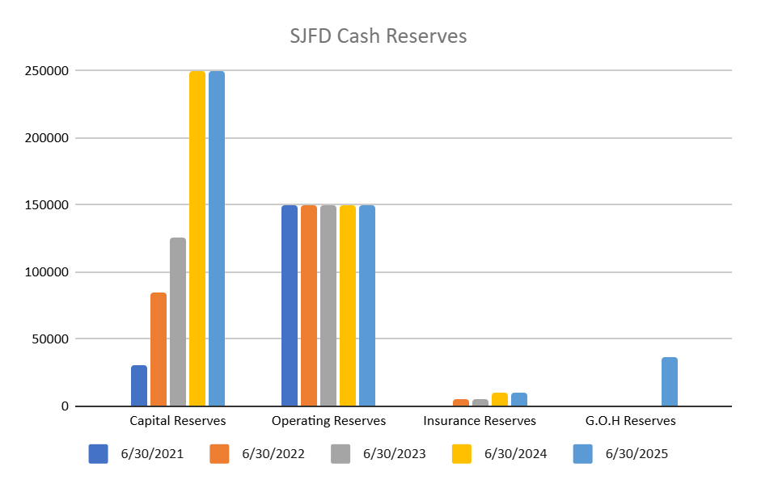
Reserve Balance FY25
Capital Reserves
$250,000
Operating Reserves
$150,000
Insurance Reserves
$10,000
G.O.H. Reserves
No Cap

Slide 19
Treasurer’s Report
Investment Strategy
Operating Cash
Federally insured accounts
Collateralized accounts
Checking or Money Market Accounts
Certificates of Deposits
Charles Schwab account
All holdings Federally Insured
Spread across multiple institutions
Varied maturity dates
Annual roll-overs
Earnings fund Garden of Honor Reserves

Slide 20
Chief’s Annual Operations Report
Volunteers By Division | YE 2024 | TD 2025
Fire | 43 | 47
EMS | 23 | 27
Fire Police | 18 | 26
Total | 84 | 105

Slide 21
Chief’s Operations Report
Responses and Responders by Division | CY 2024 Thru 11/30/24 |  | CY 2025 Thru 11/30/25
Fire | 225 | 3592 | 291 | 4248
EMS Dispatches | 938 | 4643 | 932 | 4288
EMS Transports | 158 |  | 152
Fire Police | 943 | 4122 | 958 | 4611

Slide 22
Chief’s Operations Report
•Operational Status
• All vehicles & equipment serviced and certified
• Update on 3761 & 3771 replacements
Phased replacement program for SCBA, etc. continues
OSHA requirements for turnout gear

Slide 23
Chief’s Operations Report
•Training Initiatives
•Inter-Divisional:
Air Link, Marina, Founders Club
Reserve Maintenance, Town Hall
•Mutual Aid
•Leadership Development
•SOGs updated across Divisions

Slide 24
Recruiting & Retention
Recruitment
Marina (May & September)
SJFD Open House - October 2025
St. James Leadership Conference - July 2025
St. James POA Orientation Meeting - March 2025
Retention
SJFD 2nd Annual Family Picnic - Woodlands (June)
SJFD Appreciation Dinner - Community Center (October)

Slide 25
Recruiting Report
Recruiting Events
Marina
Open House
Community Events
Word of Mouth
PR - Cat Tales, Email Blasts

Slide 26
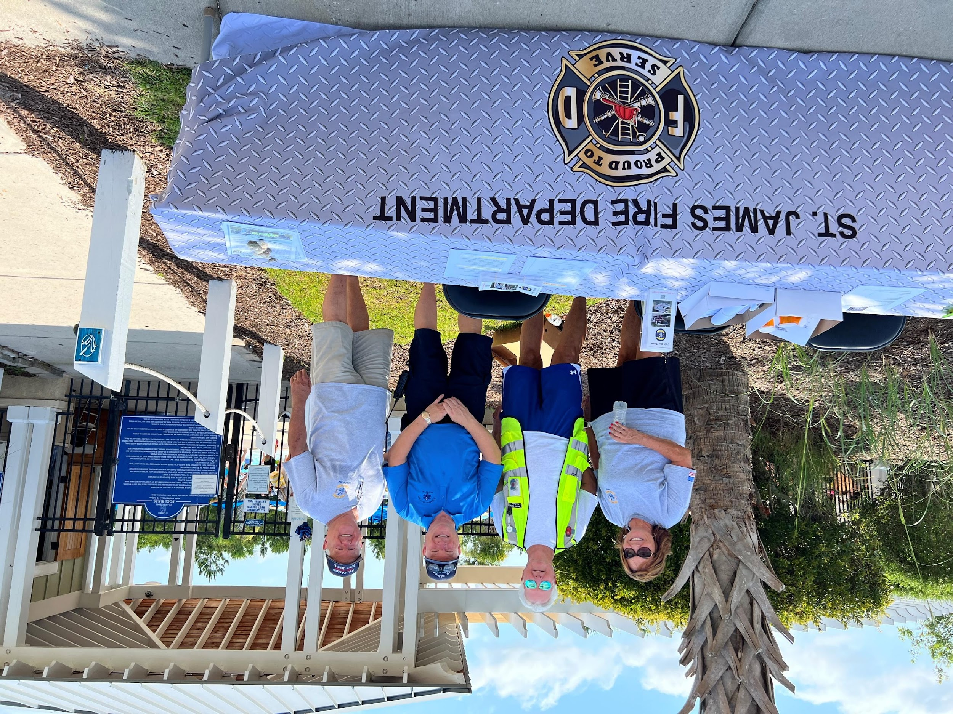
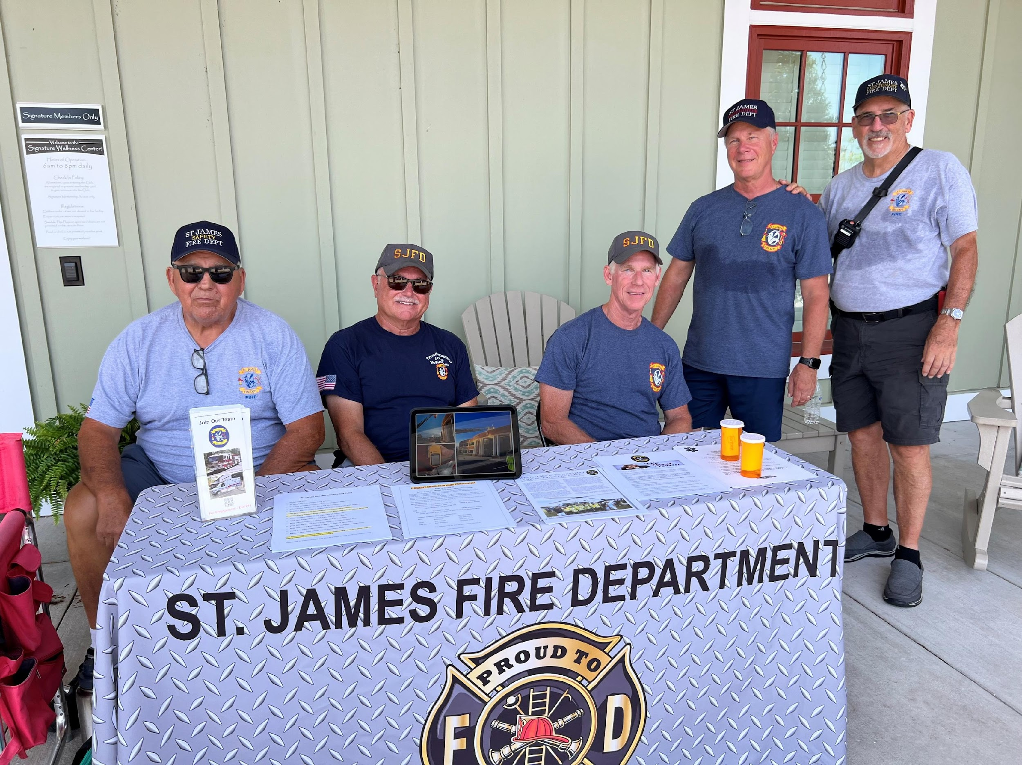
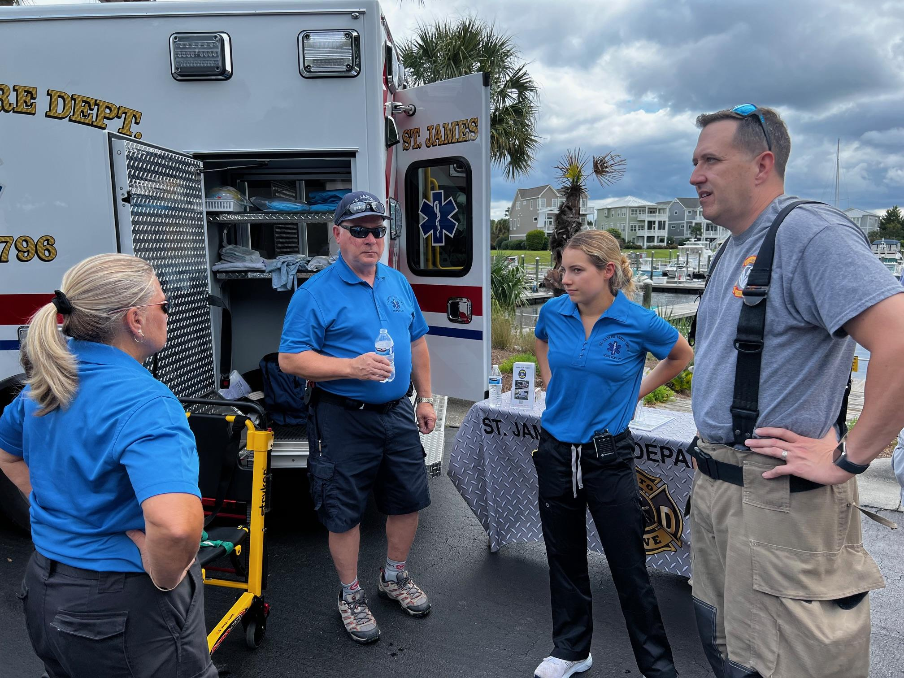
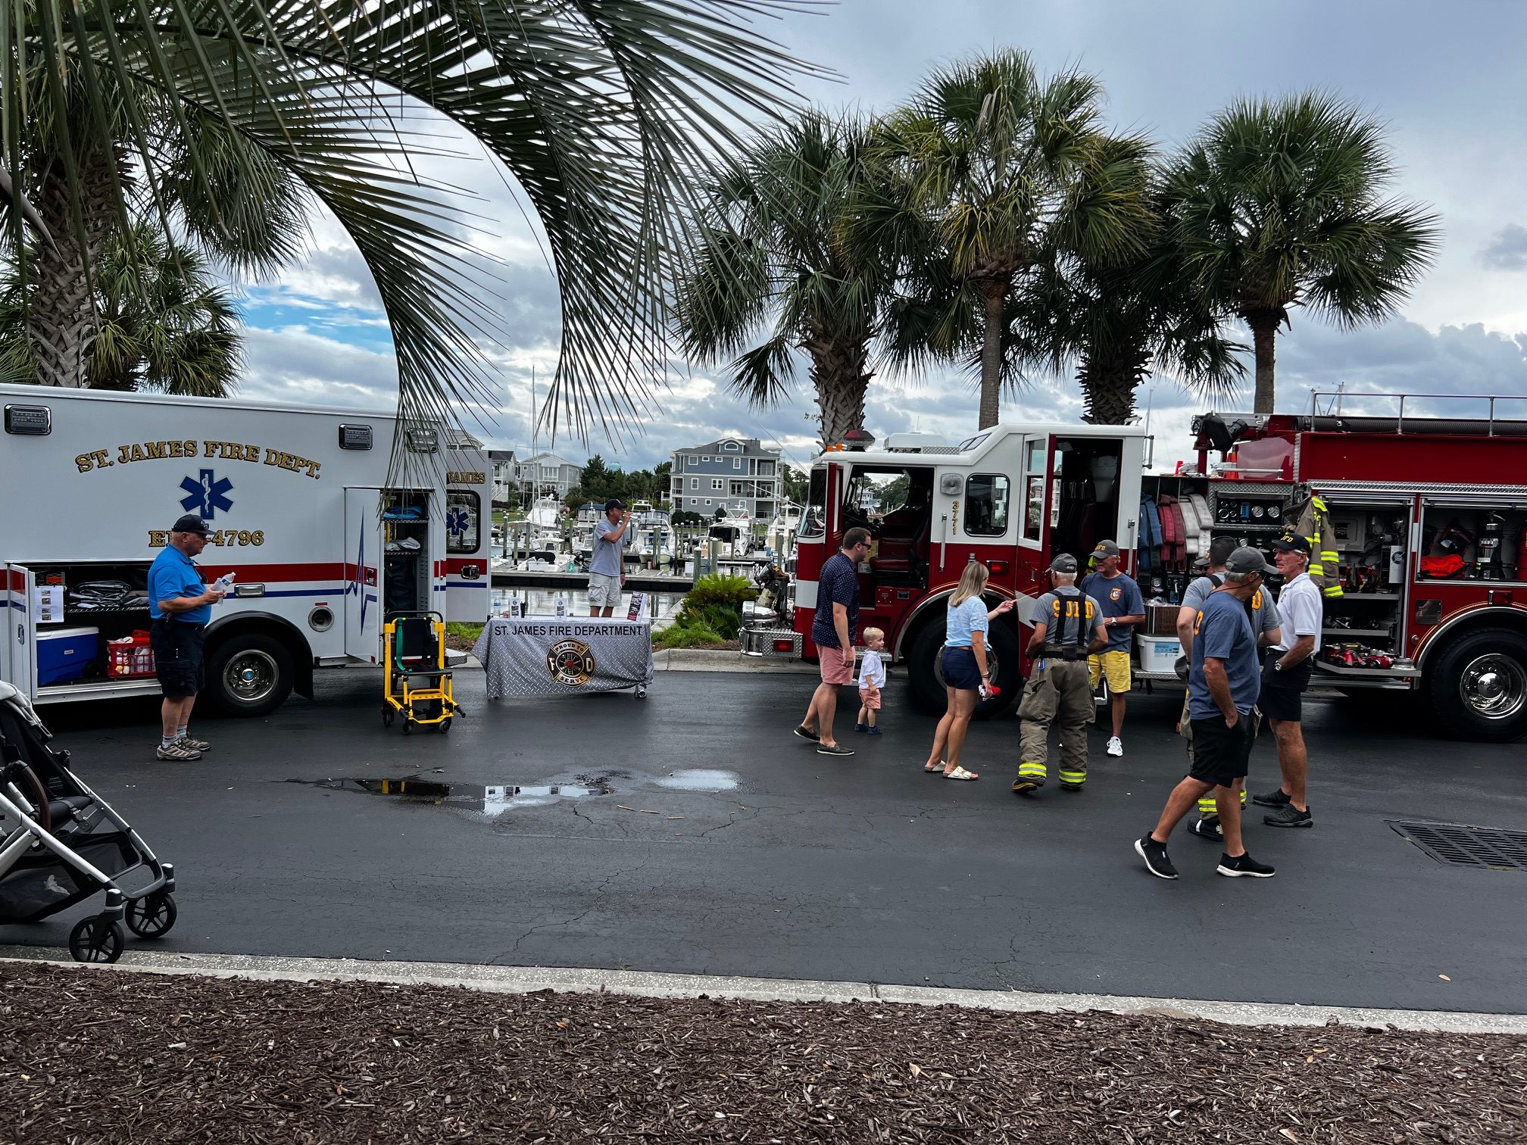
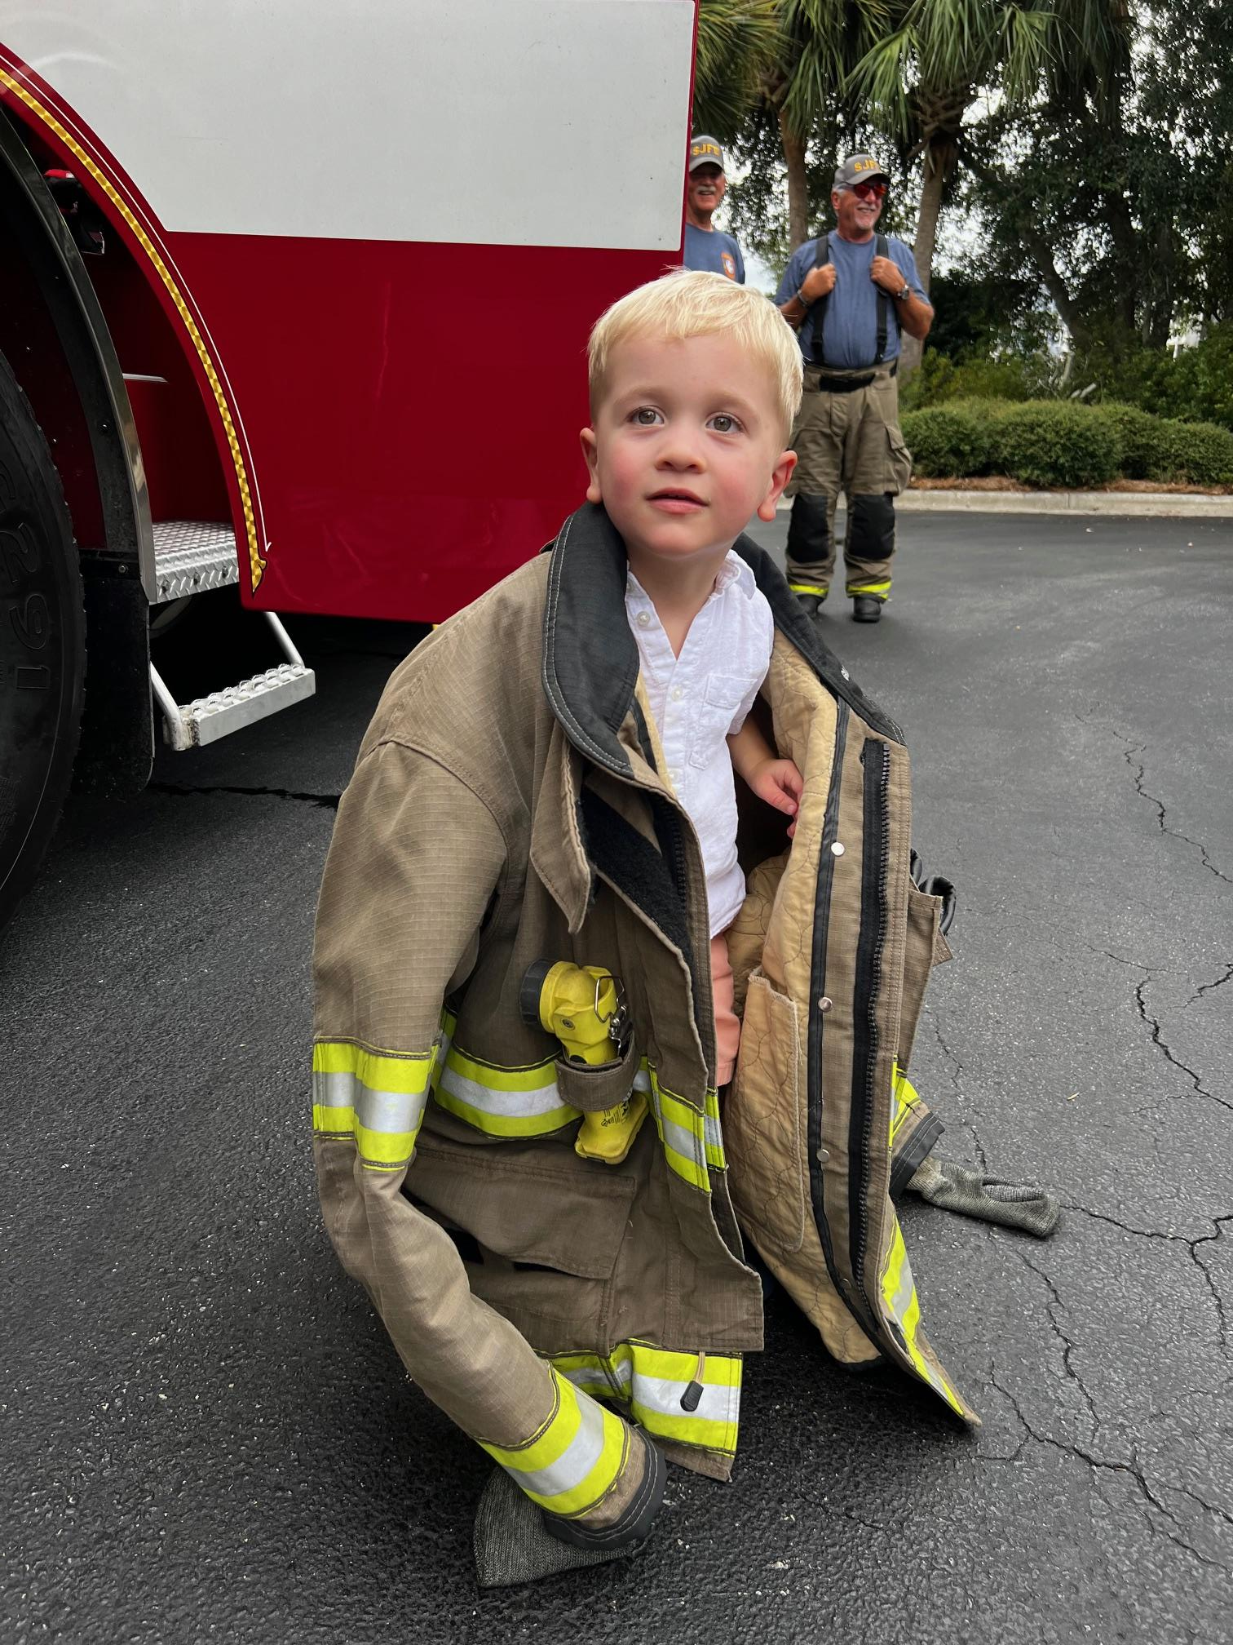
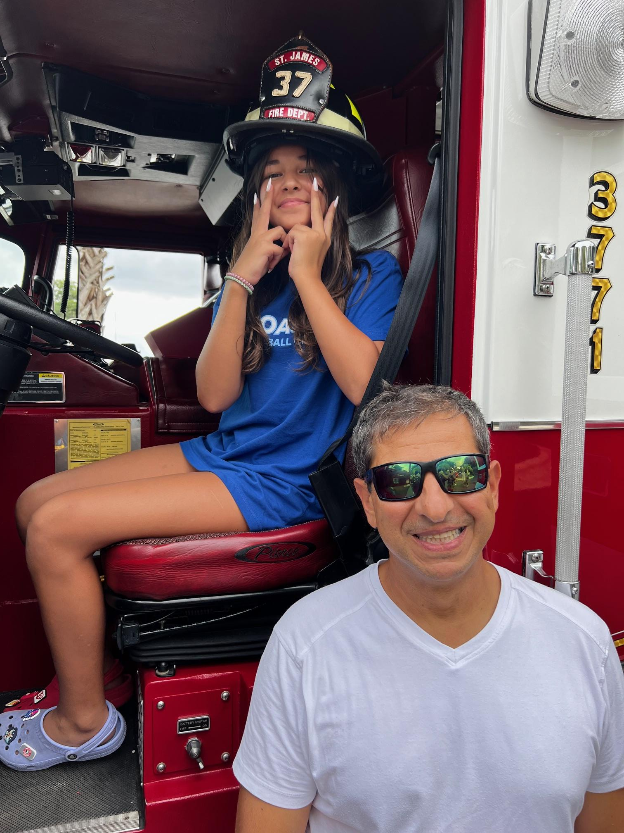
Recruiting Events - SJ Marina

Slide 27
Recruitment Goals 2026
Fire | Sta 1 | 4
Fire | Sta 2 | 4
EMS |  | 4
Fire Police | St James | 1
Fire Police | Arbor Creek | 1

Slide 28
Recruiting 2025
Summary By Candidates Status
 | Pipeline - under consideration ( from 2024) |  | 1
 | Pipeline - under consideration (New 2025) |  | 2
 | Landed - joined FIRE |  | 5
 | Landed - joined FIRE POLICE |  | 3
 | Landed - joined EMS |  | 7
 | Awaiting to see the Chief |  | 0
 | Total Landed |  | 17
 | Inactive - dropped out |  | 4
 | Total Processed to date |  | 30

Slide 29
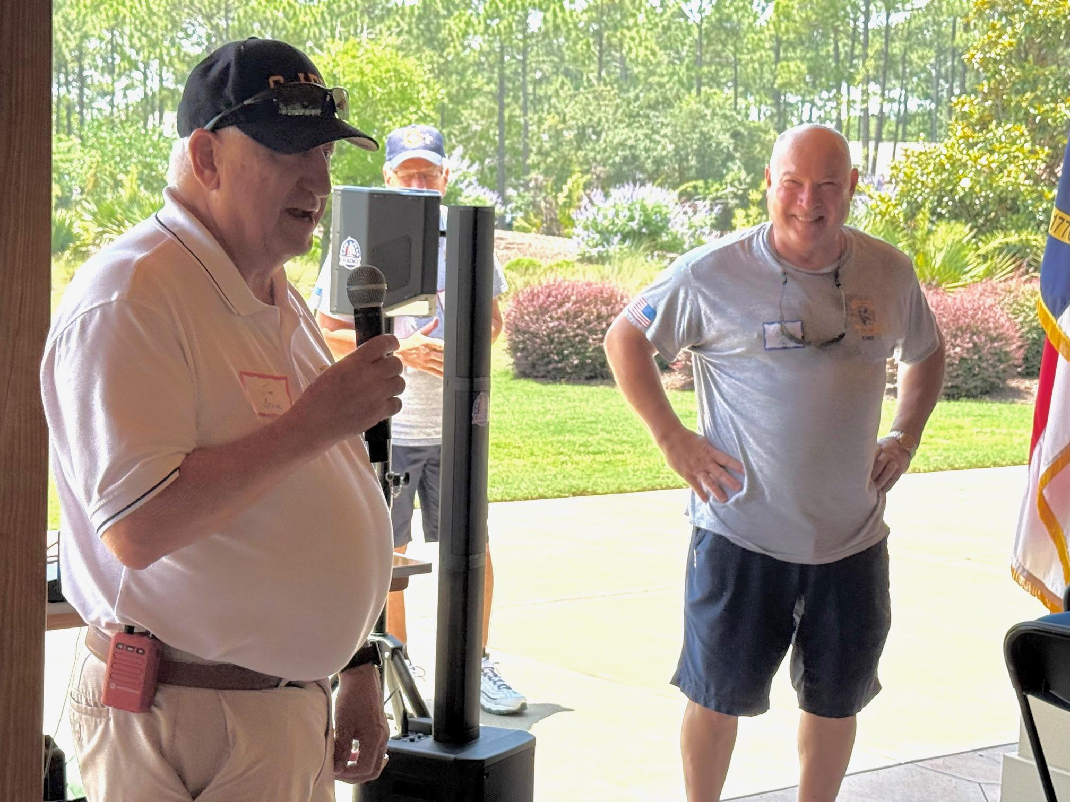
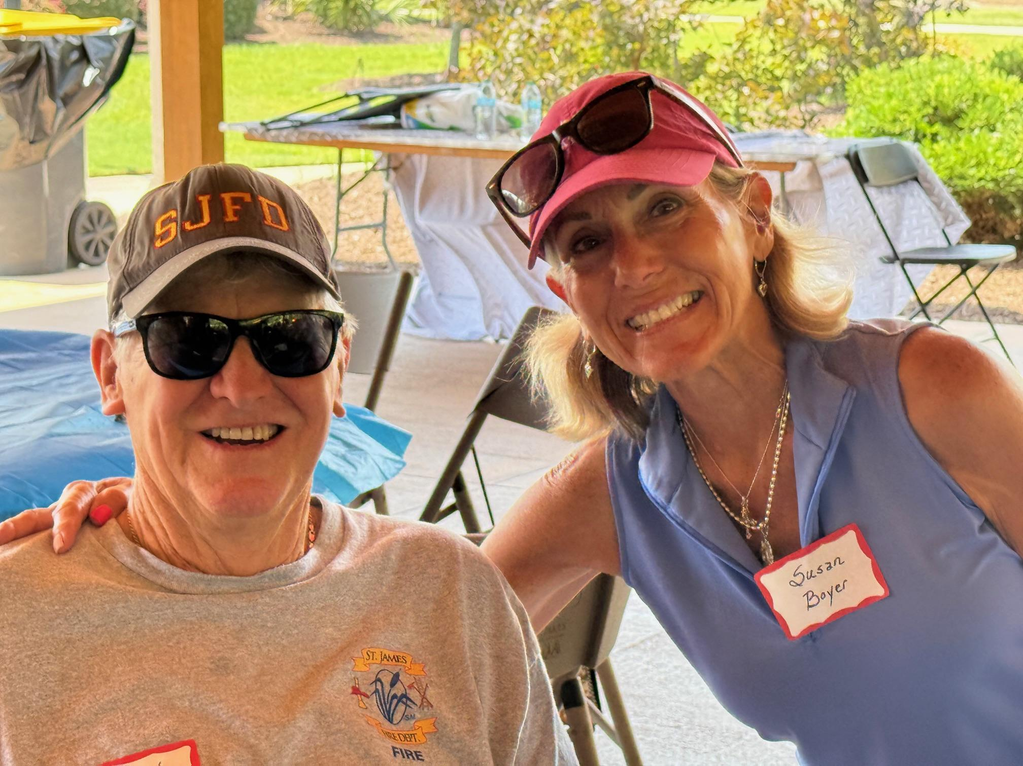
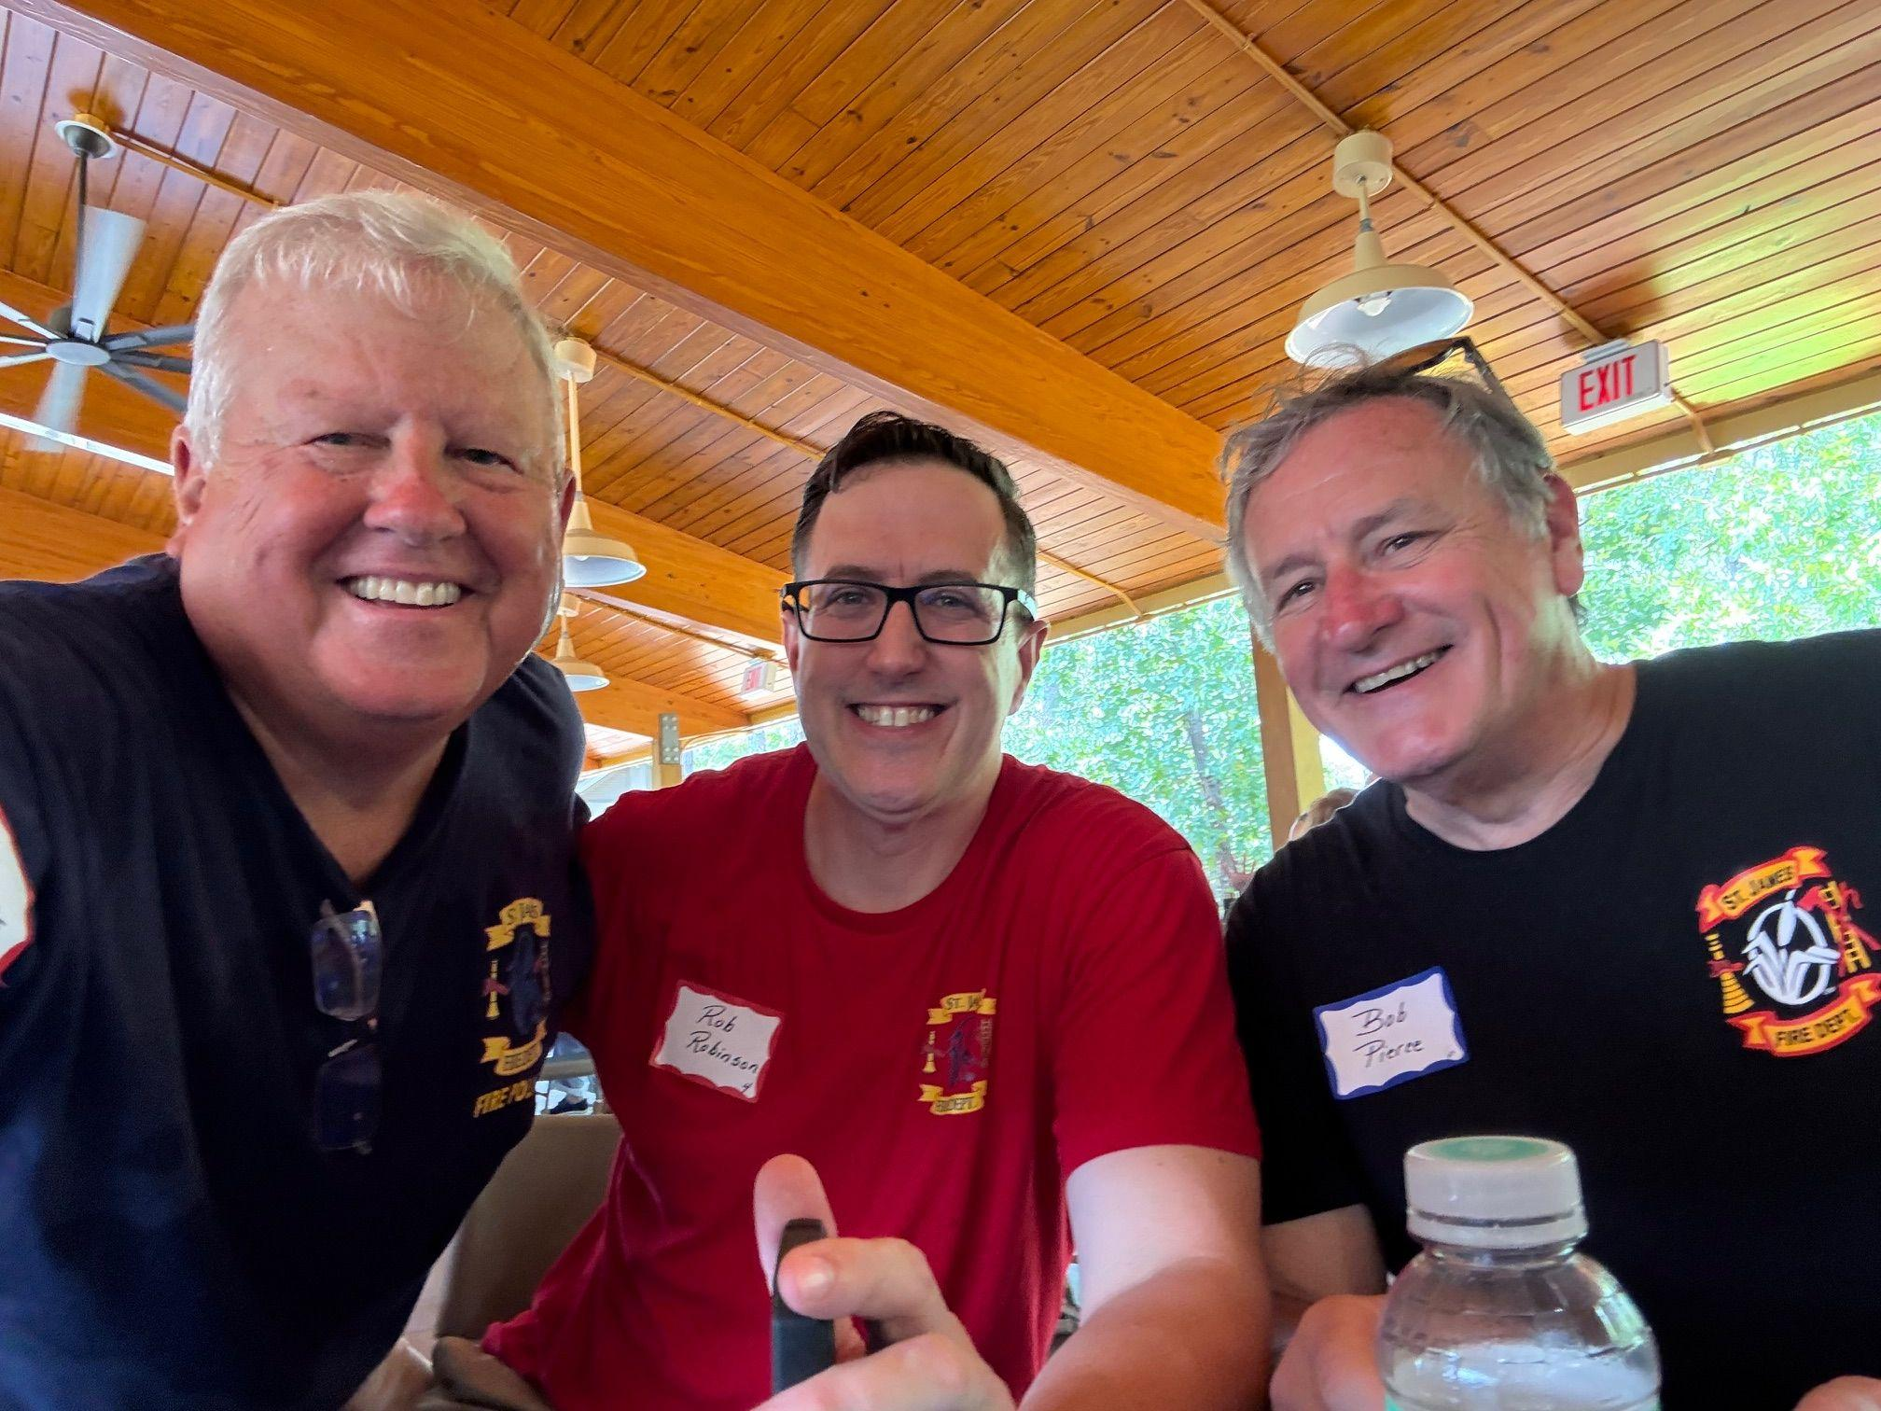
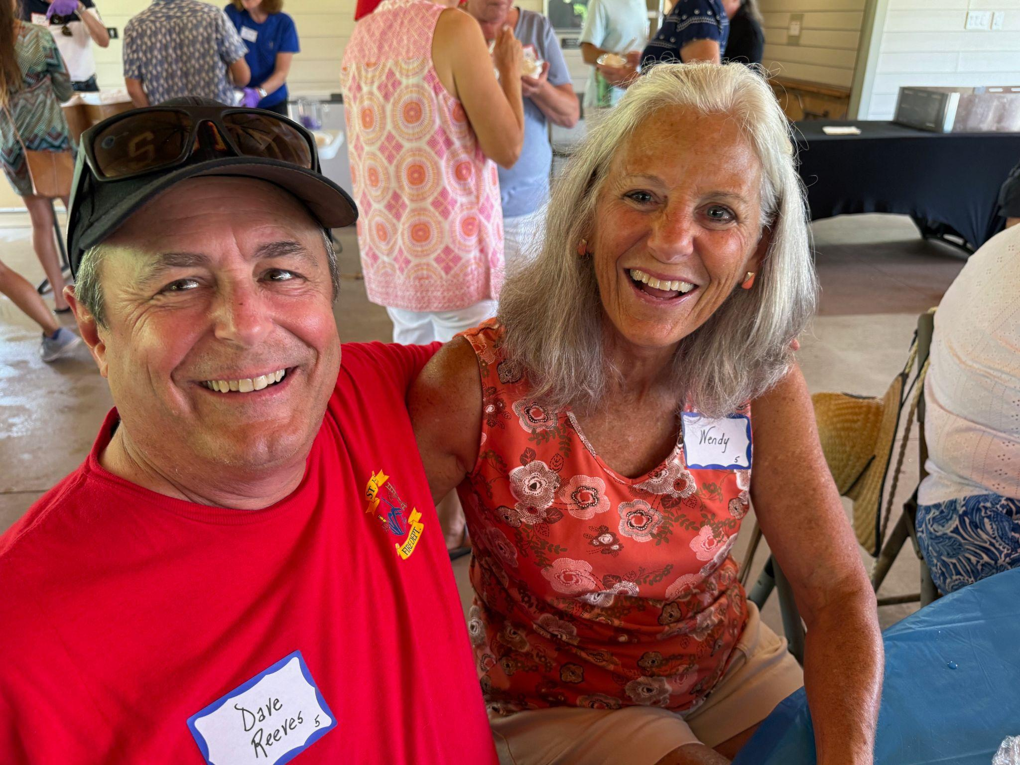
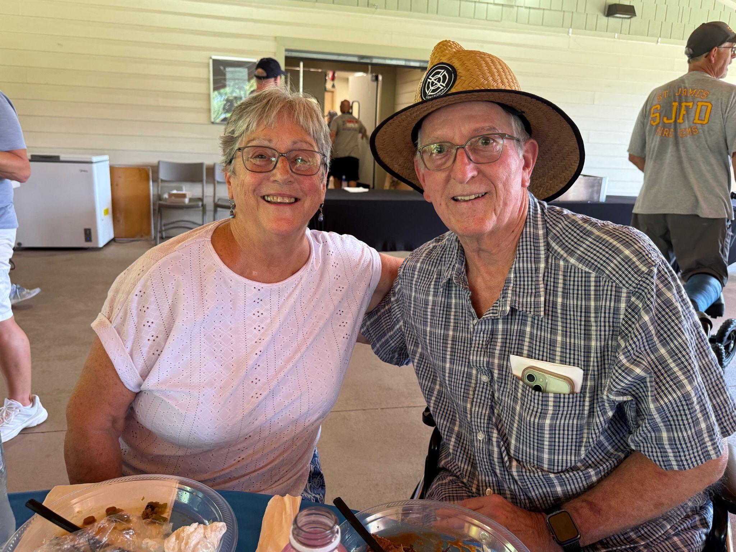
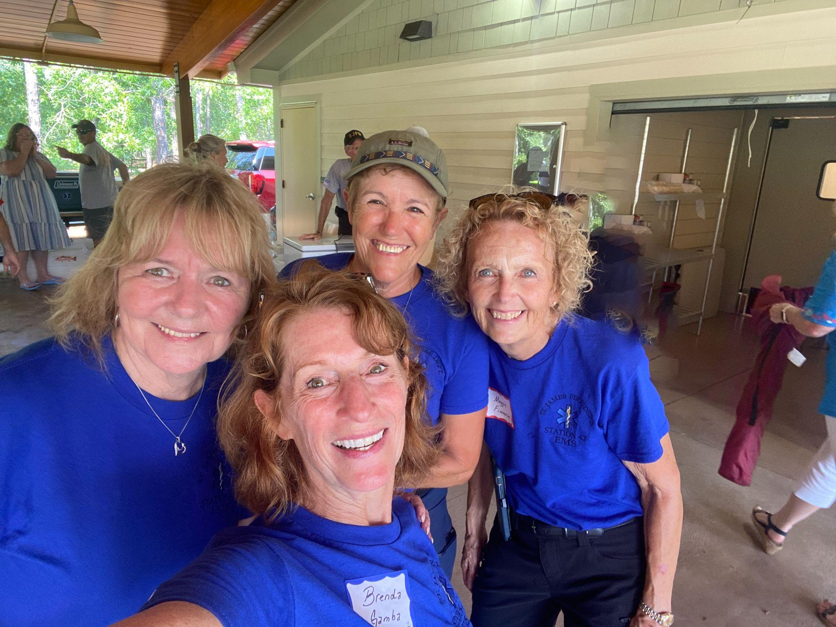
Department Picnic – Woodlands Park

Slide 30
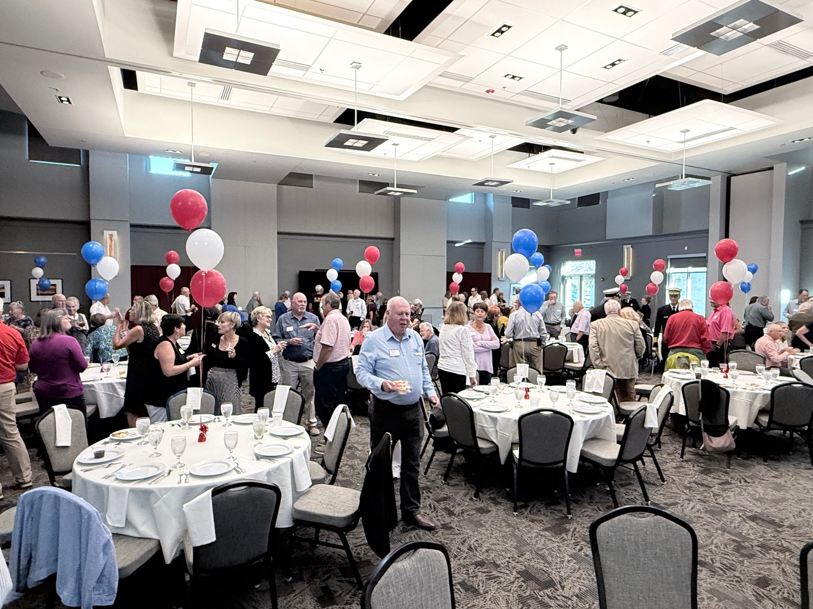
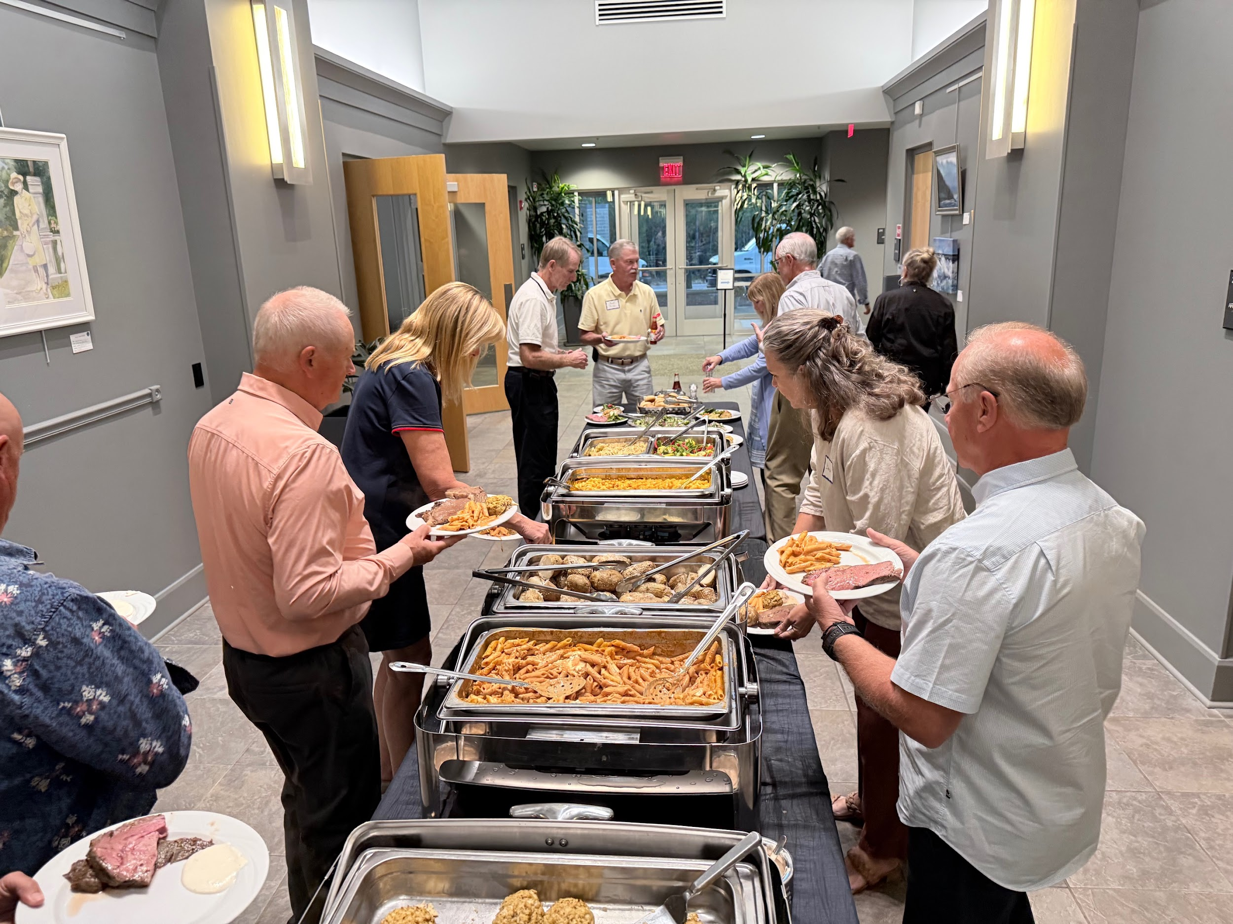
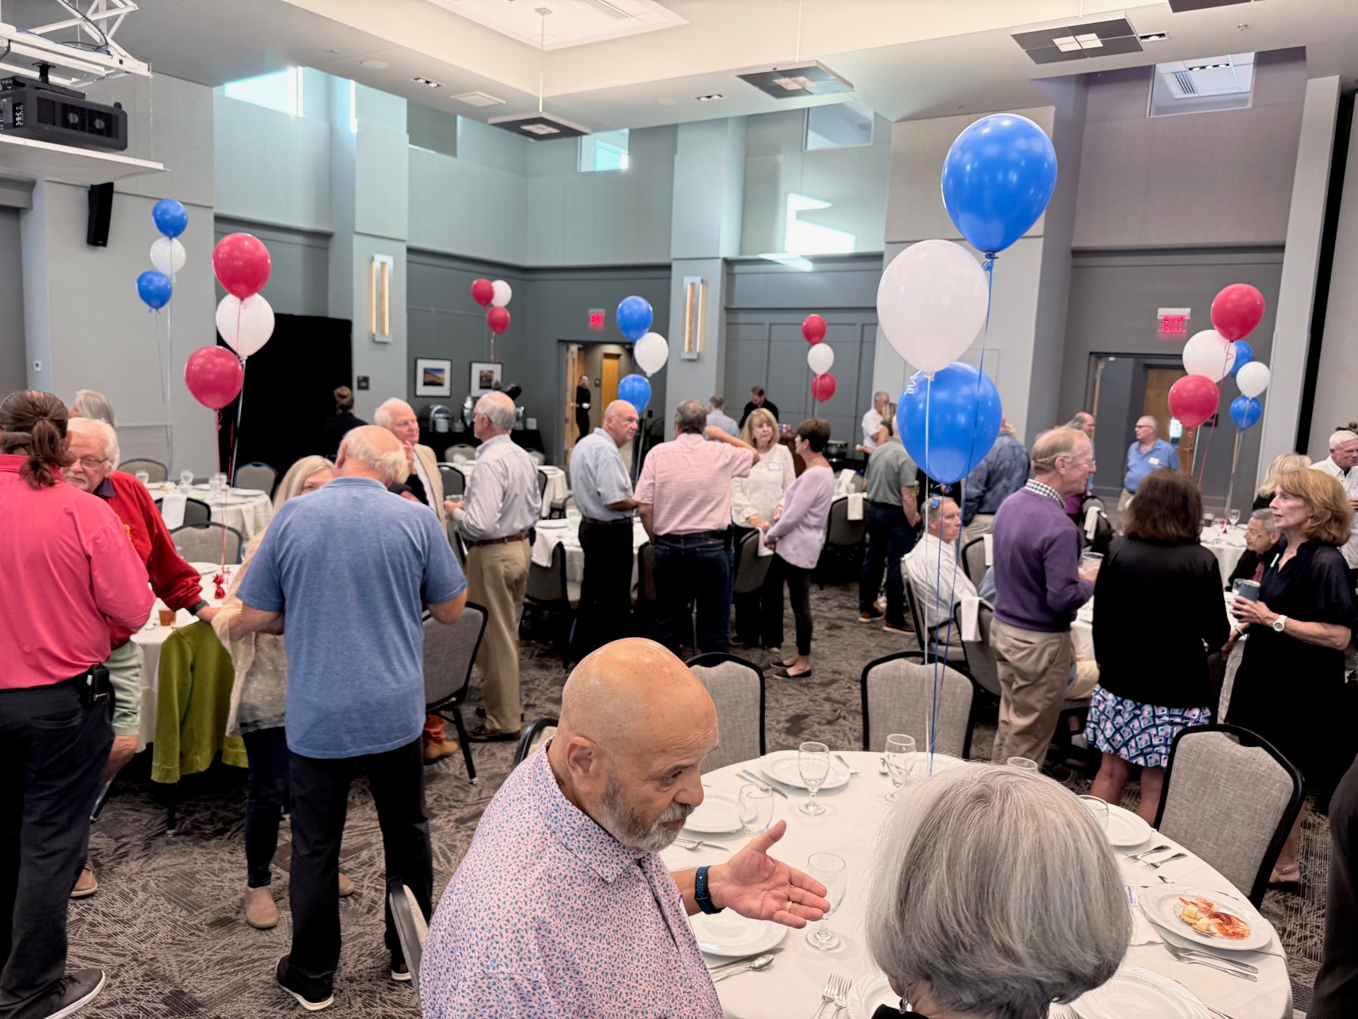
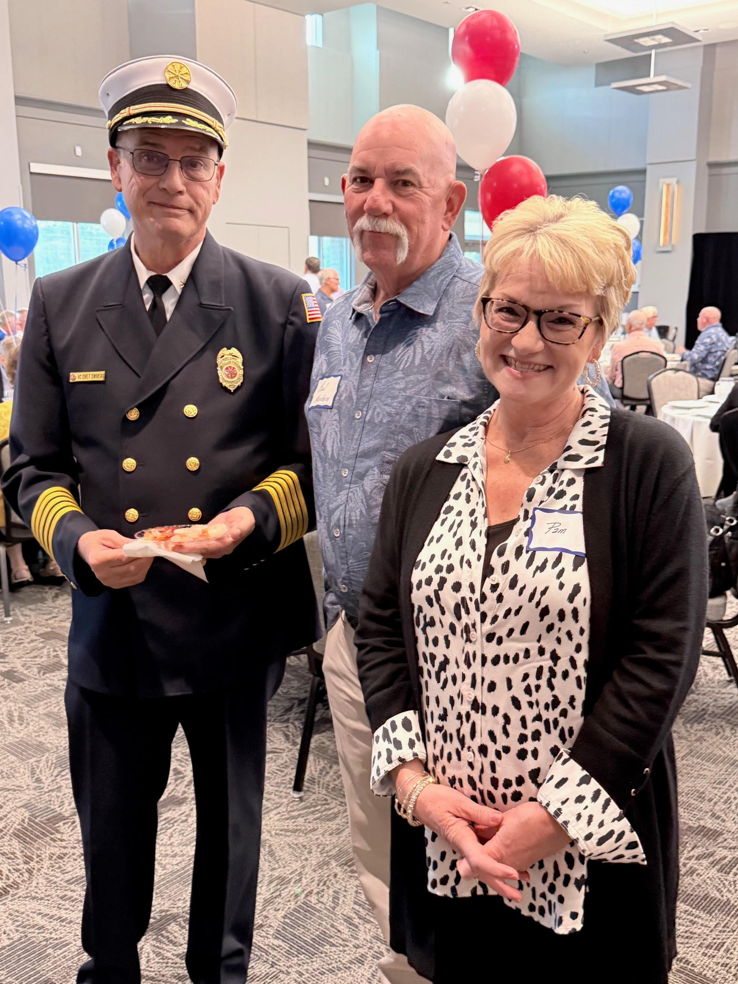
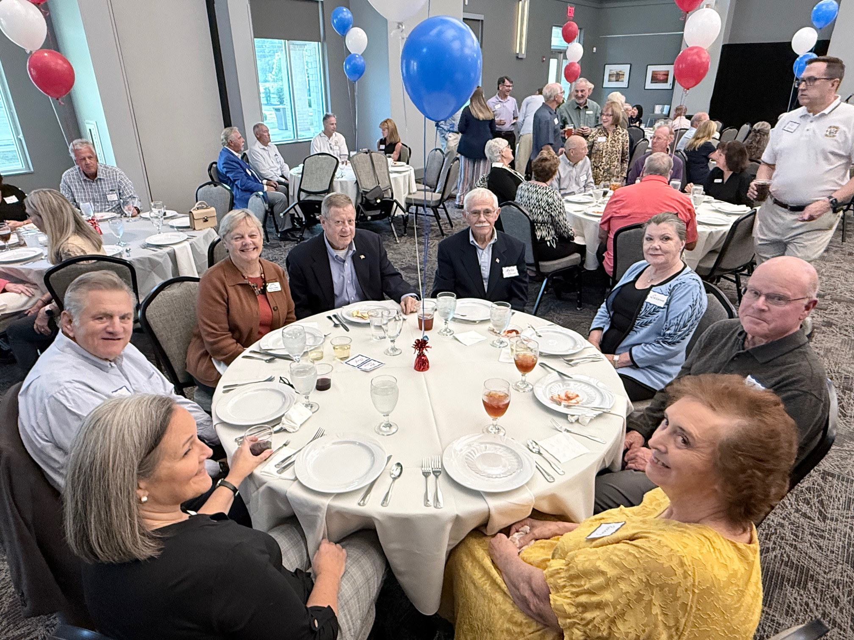
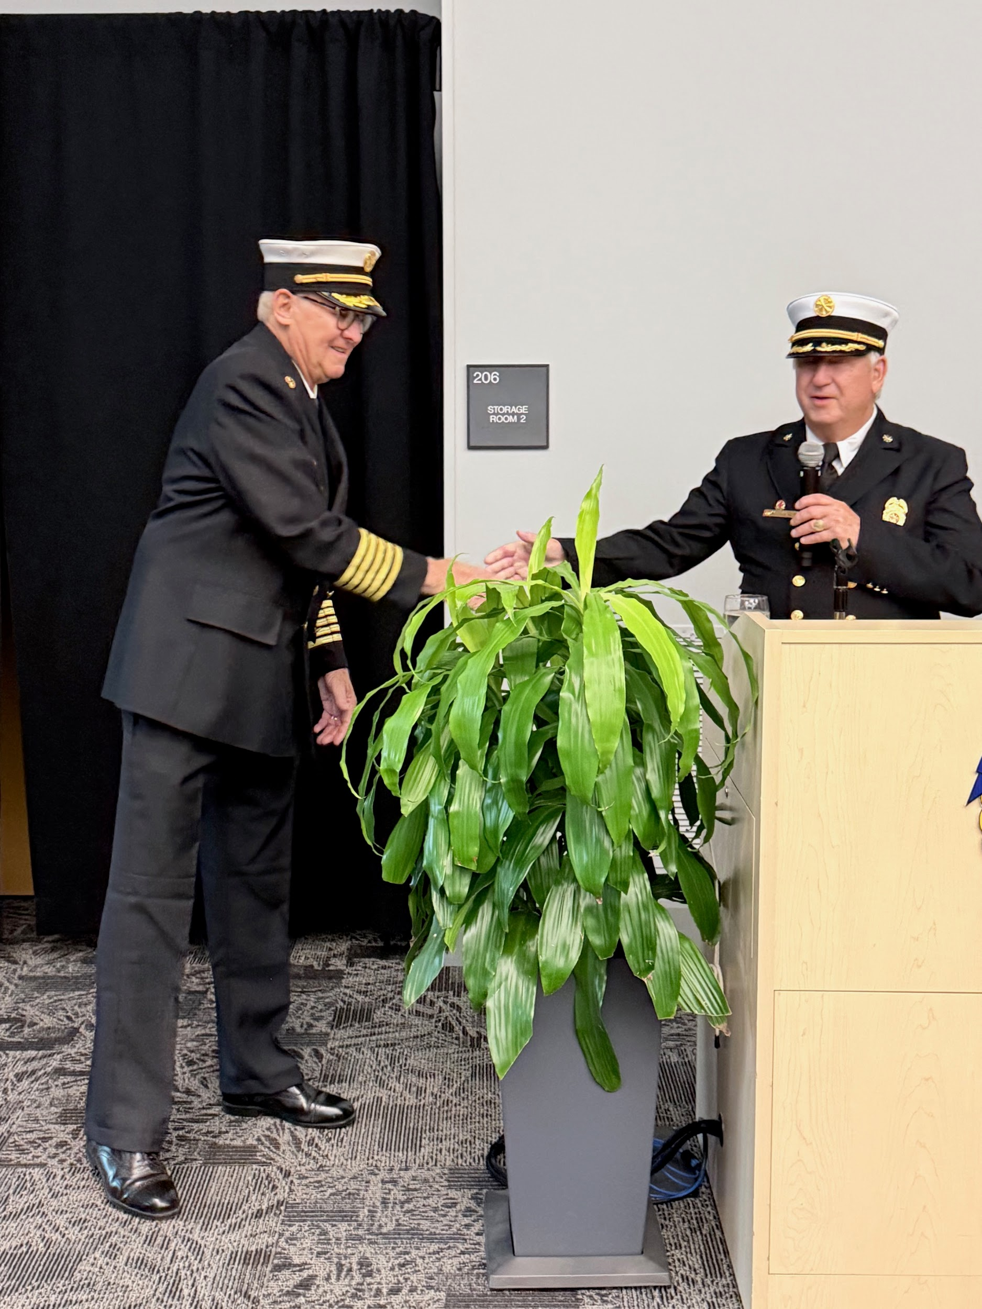
Appreciation Dinner

Slide 31
Event Highlights
Public Service
2 Shredding Days
Fishing Derby
Town Fireworks Display
Major Gas Leak
Open House

Slide 32
Public Service: Hands only CPR
Type | # of Classes | # of Students
Hands-Only | 30 | 105
POA Security AED Training | 1 | 12
Our Deepest Thanks to EMS Captain Bob Jensen and his teams for making this possible!

Slide 33
Thank You!
To Our Members
Your Board Thanks You!
Your Community Thanks You!
And I Thank You!

Slide 34
Q & A

Slide 35
Backup Slides

Slide 36
5-Year Plan Key Initiatives
Option 1
Expand Recruitment Beyond St. James Plantation
Enable Direct Response for Rural Volunteers
Infrastructure & Facilities Planning
Maintain Financial Stability
Equipment & Vehicles
Notes:
TALKING POINTS
1. Expand Recruitment Beyond St. James Plantation
Recruit volunteers from new northern developments and the Rural Fire District, with emphasis on EMS roles to meet rising call volumes.
2. Enable Direct Response for Rural Volunteers
Allow rural and development-area members to respond directly to incidents and expand Fire Police coverage beyond the gates.
3. Infrastructure & Facilities Planning
Develop a satellite facility, evaluate a future northern station, and improve access through Gate 5 for faster rural response times.
4. Maintain Financial Stability
Sustain funding partnerships, use county fees and grants, continue fundraising, and build capital reserves for future equipment.
5. Equipment & Vehicles
Replace key apparatus on schedule to meet operational demands without adding unplanned vehicle purchases.

Slide 37
5-Year Plan Key Initiatives
Option 2
Expand Recruitment Beyond St. James Plantation
Recruit volunteers from new northern developments and the Rural Fire District, with emphasis on EMS roles to meet rising call volumes.
Enable Direct Response for Rural Volunteers
Allow rural and development-area members to respond directly to incidents and expand Fire Police coverage beyond the gates.
Infrastructure & Facilities Planning
Develop a satellite facility, evaluate a future northern station, and improve access through Gate 5 for faster rural response times.
Maintain Financial Stability
Sustain funding partnerships, use county fees and grants, continue fundraising, and build capital reserves for future equipment.
Equipment & Vehicles
Replace key apparatus on schedule to meet operational demands without adding unplanned vehicle purchases.

